Slide 1

VEHICLE OR OBJECT DETECTION USING
LI-DAR AND CAMERA FUSION
* PRESENTED BY:
* JV’N YASHI SINGHAL
* JV’N RITIKA OLA
* JV’N GARIMA PANT

Slide 2
TOPIC
OBJECT /VEHICLE
DETECTION DURING
FOG
USING
LI-DAR
AND
CAMERA
FUSION

Slide 3
CONTENT:
INTRODUCTION
HARDWARE USED:
2.1 LI-DAR
2.2 CAMERA
3.SENSOR FUSION
4.ADVANTAGES
5.FUTURE SCOPE
6.CONCLUSION
1. INTRODUCTION

Slide 4
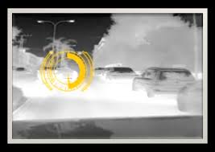
INTRODUCTION
Due to foggy environment object become or unclear.
Collision avoidance system has become necessity.
Multiple sensor:
Camera.
LI-DAR.

Slide 5
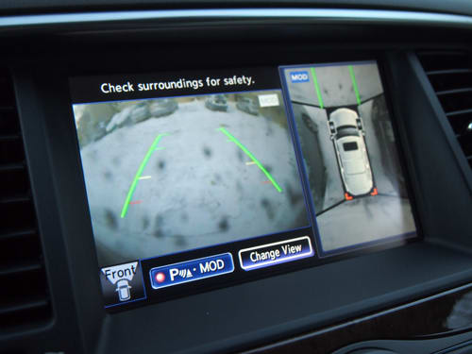
2. HARDWARE USED:
2.1 CAMERA: The eye of
autonomous vehicle.
Display images on screen.
Takes picture of moving vehicle
,send image to
central handling unit.
Rear or 360° camera supports driver with better representation of an environment .

Slide 6
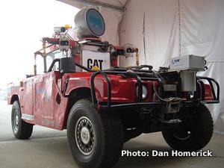
2.2 LI-DAR
provide a 360° horizontal field of view (FOV).
gives highly accurate depth values.
Direct a small light on a surface and measure the time required to return to its source.
Fig: A self driving car
consists of LI-DAR

Slide 7
DEMONSTRATING DETECTION OF OBJECTS

Slide 8
SENSOR FUSION
Combination of LI-DAR and Camera helps to overcome their individual limitations.
Can done in two ways:
Fusion of data:
overlapping camera image and LI-DAR point cloud to get depth information for the pixels in the camera image.
Fusion of result:
Here ,object detection in camera image and in LI-DAR point cloud separately done, fuse the results to increase our confidence.

Slide 9
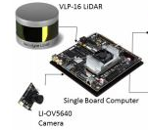
ADVANTAGES :
Cost effective
Accuracy
Capability

Slide 10
FUTURE SCOPE
This technology is helping a lot to reduce number of accidents occurring per day.
In future, it seems that more enhancing features in 3D models will come that will provide more enhanced view and plays major role in enhancing technologies.

Slide 11
CONCLUSION:
Nowadays automotive industry is developing and producing innovative driving assistance functions to support the vehicle drivers.
Main motive is to improve driving security and collision avoidance.

Slide 12
THANK YOU

